Slide 1
CASE STUDY OF Predicting Mortgage Backed Securities Using Machine Learning Methods
DIVIT A KALATHIL

Slide 2
INTRODUCTION
A mortgage-backed security (MBS) is an investment similar to a bond that is made up of a bundle of home loans bought from the banks that issued them.
Investors in MBS receive periodic payments similar to bond coupon payments.
A key method of predicting the mortgage payments is statistical modelling along with empirical research achieved by analysing the data.
A number of variables such as borrower credit score, income, loan to value ratio and loan age are used by researchers. These are used to predict the prepayment risk using machine learning techniques.

Slide 3
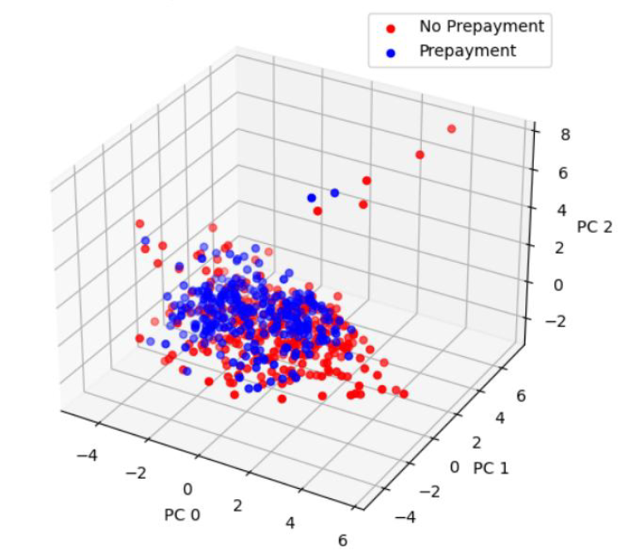
DATASET
Data from Freddie Mac, Federal Housing Finance Agency and US Bureau of Labor Statistics. On sampling this we could form a final dataset containing 2 million records between January 1,1999 and September 30th ,2020
The adjacent plot gives a simple visualization of the processed data for a standard loan level dataset. Blue and red points represent components who have done prepayment and non prepayment respectively.

Slide 4
FEATURES
Merging the two pieces of data by loan id, we could form a dataset where each row contained loan information and their performance for each month.
I added certain macroeconomic indicators such as mortgage rate, housing price appreciation and unemployment rate
After pre-processing the data, the dataset contains a total of 95 features with a 60% train , 20% validation and 20% test data split.
As it is visible the prepaid observations are on the top of non-prepaid ones which demonstrates a successful classification model.

Slide 5


MODEL IMPLEMENTATION
Logistic Regression:
We can implement this model by assuming a linear relationship which results in a linear classifier.
Loss Function:
Support Vector Machine:
Obtain a desirable linear hyper-plane to maximize the linear separation between classes.
Gaussian Discriminant Analysis:
Creating Gaussian distributions for each class, followed by classification of a new data point by evaluating the probability. GDA specifically has two forms linear and quadratic.
Neural Networks:
Neural networks are formed by stacking and layering neurons, and each neuron will have its inputs and weights attached to it. We can train the neural networks to calculate the gradient of its loss functions

Slide 6
RESULTS(Source from paper)
The trained SVM polynomial classifier resulted in an accuracy of 98.854% whereas the radial basis function and sigmoid functions are found to be more accurate.
The logistic regression model resulted in a maximum 100% prediction accuracy and an overall accuracy of 99.951%
Neural network and Gaussian Discriminant Analysis(Quadratic) implementation in this case is most eﬃcient way to predict the results. In this case the training error was extremely low at 0.04%.

Slide 7
CONCLUSION & FUTURE WORK
The GDA with a quadratic decision boundary performed very well overall, and could predict when the pre payments would occur on a periodic basis. The logistic regression worked perfectly during non prepayment.
Using this we can ensemble model, using which we can vote on the final output.
This work turned MBS into a classification problem at its own level.
Most of the models eclipsed the 99% mark, the logistic regression was the second best whereas the GDA emerged to be a winner.
More research needs to be done for rigorous comparison of these models, and more feature engineering can be explored.

